Slide 1

PROJECT REVIEW - 2
EXAM PREPARATION SYSTEM
Exam Preparation with Adaptive Quizzes
DATABASE SYSTEMS ENGINEERING AND DISTRIBUTED BACKEND DEVELOPMENT
TEAM - 26
2520030385 Tanvitha
2520030069 Hemaswi
2520030350 Vedika

Slide 2

01
Abstract
Traditional exam preparation relies on static question banks and fixed-difficulty mock tests that treat every student identically, regardless of their individual strengths and weaknesses.
This project proposes an adaptive quiz system for exam preparation that continuously analyzes a learner's responses to select questions matched to their current proficiency. By combining topic-wise performance tracking with an adaptive difficulty engine, the system identifies weak areas in real time and steers practice toward them.
The result is a personalized, efficient revision experience — replacing one-size-fits-all practice with a targeted path that improves retention, saves preparation time, and gives learners clear visibility into their exam readiness.
3x
100%
Real-time
Adaptive learning, powered by real-time performance data.
Faster targeting
of weak topics
Personalized
question sequencing
Feedback &
progress insight
01

Slide 3




02
Problem Statement
Why static exam-prep tools fall short of real student needs
One-size-fits-all practice
Time wasted on mastered topics
Every learner receives the same fixed set of questions and difficulty level, ignoring differences in ability and pace.
Students keep re-solving questions they've already mastered instead of focusing effort on weak areas.
No real-time proficiency tracking
Delayed, generic feedback
Progress is rarely measured topic-wise during preparation, so weak spots surface only in the final exam.
Static tools give scores after the fact with little explanation, limiting how much a student can learn from mistakes.
02

Slide 4

03
Existing vs. Proposed System
Existing System
Proposed System
Fixed question bank — same set and order for every student
Dynamic question selection driven by live performance data
Uniform difficulty; no adjustment to learner ability
Adaptive difficulty engine tunes each question to current skill
Manual, infrequent progress tracking with limited analytics
Automated topic-wise analytics dashboard, updated continuously
Generic study material, not mapped to individual gaps
Personalized study path generated per student, per weak area
Feedback delayed until after the test, with little explanation
Instant feedback and explanations right after each question
03

Slide 5
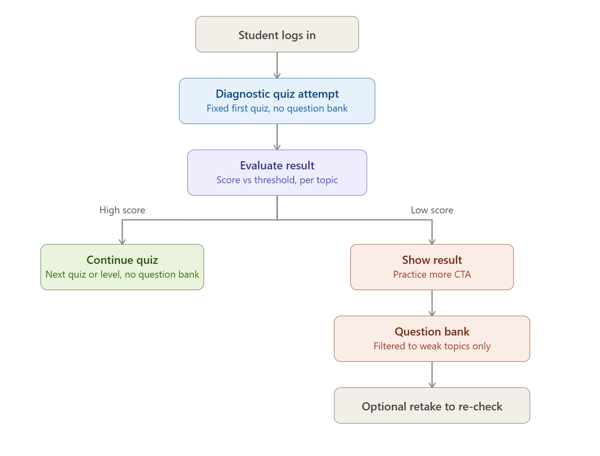
04
Proposed System Architecture
04

Slide 6






05
Tools Used to Implement
Technology stack across frontend, backend, adaptive engine, and hosting
React / React Native
Python (Flask / Django)
Scikit-learn / TensorFlow
Web & mobile quiz interface
Backend & API services
Adaptive difficulty & ML model
MySQL / Firebase
AWS / Google Cloud
Git & GitHub
Student profiles & question bank
Hosting & scalable deployment
Version control & collaboration
05

Slide 7
Thank You
Exam Preparation with Adaptive Quizzes
TEAM - 26
2520030385 Tanvitha 2520030069 Hemaswi 2520030350 Vedika
06

